Slide 1
Mrs. Appleyard’s Kindergarten Burton Elementary School
This Photo by Unknown Author is licensed under CC BY-SA-NC

Slide 2
Our Code of Conduct
SCHOOL- WIDE EXPECTATIONS
Be kind. Follow Adult Direction. Own your behavior.
At BES, Students will… | Classrooms | Hallways | Washrooms | Playgrounds | Bus Zone
Be Respectful | -Listen and accept others’ ideas or opinions when they are talking -Use appropriate volume | -Use quiet voice/feet -Respect belongings of others | -Use quiet voice -Respect privacy -Use supplies properly | -Respect nature | -Use quiet voice -Wait patiently
Be Responsible | -Take care of materials and workspace -Follow routines -Be aware of surroundings | -Take care of belongings | -Clean up after yourself -Ask to go at appropriate times -Flush and wash | -Follow entry/exit routines -Use your W.I.T.S. | -Be aware of your surroundings -Stay with your line
Be Safe | -Move safely -Hands and feet to self -Use tools and materials appropriately | -Walk -Stay to the righthand side -hands and feet to self | - walk -Keep water in sink and toilets -hands and feet to self | -Move safely inside boundaries -Dress for weather -Use equipment safely | -Walk -Hands and feet to self -Follow the bus rules -Dress for the weather
Be a learner. | -Use whole body listening -Do your best work -Persevere | -Get ready quickly and quietly -Return to class quickly | Return to class quickly | -Play fair -Practice Sportsmanship when winning or losing -Be a problem solver | -Know the bus rules

Slide 3
Supplies
Change of clothes (pants, shirt, underwear, lots of socks -all labeled with name and stored in a plastic bag labeled with name)
Indoor sneakers (preferably Velcro)
Large book bag and lunch box
Water bottle (labeled with name)
2 community masks
$30.00 for remaining school supplies and a $10 Agenda fee (Please pay both fees via School Cash Online).

Slide 4
Kindergarten Day
7:40-7:45 – Bus will arrive at school
7:45 – 7: 55 – Parent drop off time (Students proceed directly to their class)
Breakfast items available in the classroom upon arrival
8:00-Instruction Begins
Students will have a snack before morning recess
10:00 - 10:20 - Recess
11:30 -11:55 - Lunch
12:00 – 12:25 - Recess
1:40-Bus Dismissal (11:45 on Friday)
1:45 – Parent pick up (students will stay in the school until this time)
Parents may pick up their child outside after the bus has left
Students will have Phys Ed on Monday - Thursday mornings.
Library will be on Friday morning. Books must be returned every Friday in
order to borrow a new book.

Slide 5
Snacks and Lunches
Students will need a healthy morning snack, a lunch, and a filled water bottle. (no lunch on Friday)
Please do not send food that requires heating
Please teach your child the difference between their healthy morning snack, lunch, and dessert
Please label water bottles and containers
Please send spoons/forks if your child will need them for their food
We are currently allowing nut products. However this is subject to change.
Hot lunch and milk will begin in October. Payment will be made on “Cash Online”.

Slide 6
Washroom and Self-Help
Students must use the washroom independently (wiping, washing hands, changing clothing if they have an accident)
Please send your child wearing footwear and clothing that they can put on /take off independently
Please send new clothing/socks if soiled clothing is sent home.

Slide 7
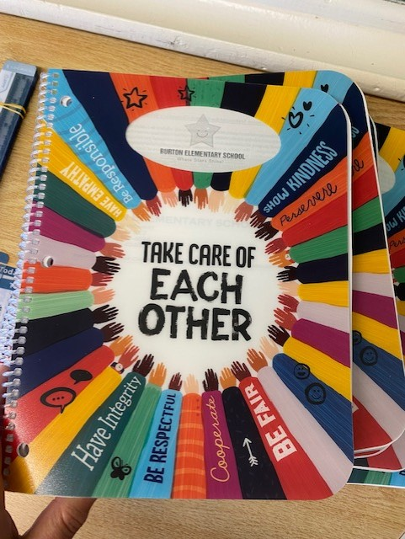
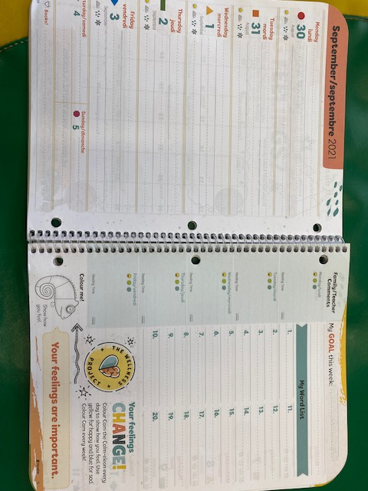
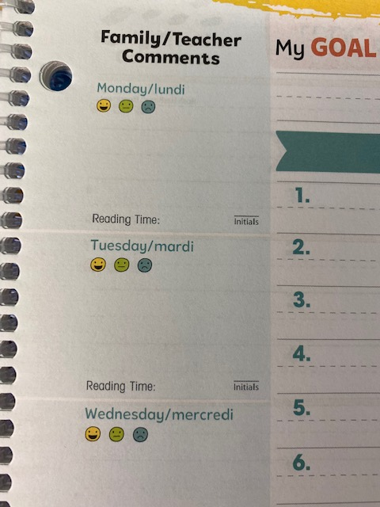
Agendas
Your child will receive their agenda on the first day of school. The agenda will travel back and forth to school/home each day. Please check the agendas every evening for communication from the school, and I will check them every morning for communication from home. (front pocket and inside dated page)
Please check the “Family/Teacher Comments” section every day. I will circle the appropriate face each day to indicate how their day was at school.

Slide 8
Homework
Homework will be sent home every Monday beginning late September. Please return it on Friday. (please keep it until Friday even if it is completed early)
Phonics homework will be sent home in the Fall.
Reading homework will be added in the Winter

Slide 9
General Information
Star Student –a student will be randomly chosen each day. They will get to be “in the spotlight” for the day. (line leader, special seat, name in our morning message…)
Please do not send toys to school
Please label all items sent to school with your child’s name
We will be using “Cash Online” for parent payments
Please check our school website regularly for information https://secure1.nbed.nb.ca/sites/ASD-W/burton/Pages/default.aspx

